Slide 1
Models and Representations
SIDN: An IAP Practicum 2020
David Bau, Anthony Bau, Yonatan Belinkov

Slide 2
Global explanations
So far we have focused on explaining decisions: why does a model makes a certain prediction on one instance?
This class is about explaining models: what does a model learn after it is trained?
These are global explanations, pertaining to full models or model components and representations.

Slide 3
Background
Before deep learning took over, we used to have feature-engineered models
In vision: wavelets, Gabor filters, SIFT and HOG patterns
In language: parts of speech, morphology, syntax, semantics
Now we have end-to-end networks trained on input-output pairs
Do all these features emerge naturally in networks?
[Figure: universaldependencies.org]

Slide 4
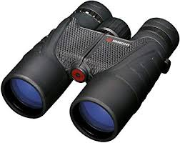
Approach
What does the network know?
R: a representation from the model
Q: some query concept we care about
f: R → Q: some computational model
We need to define Q, R, and f.
concept
Q
f
deep net
R
data representation

Slide 5
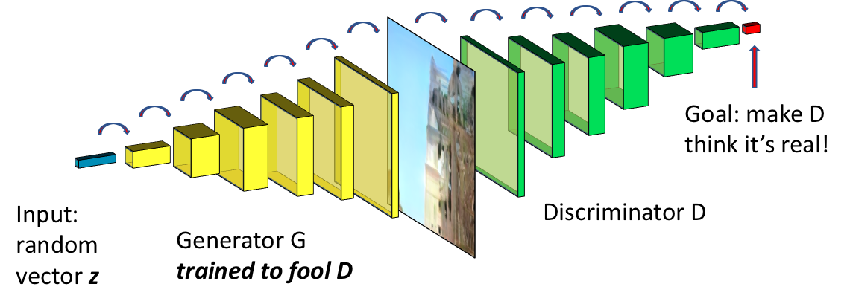
Vision
We will look at a GAN model, trained unsupervised to generate realistic images.

Slide 6
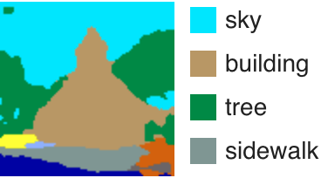
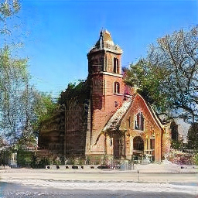
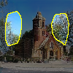
Vision: probing segmentations
Q: a semantic segmentation class
R: a single convolutional filter within the network.
f: R → Q: simple thresholding of a single filter.

Slide 7
Vision lab
http://bit.ly/sidn-gandissect
bit.ly/sidn-gandissect

Slide 8
Vision lab Exercise 1.
http://bit.ly/sidn-gandissect
Exercise 1: visualize the representations directly.
Are all the channels similar, or are some very different?
(5 minutes)

Slide 9
Exercise 1. Looking directly inside a GAN.
http://bit.ly/sidn-gandissect
Remember: the GAN is trained without supervision of any labels.

Slide 10
Vision lab exercise 2.
http://bit.ly/sidn-gandissect
Exercise 2. What is represented?
Run the segmentations.
Do any of the channels correlate with concepts meaningful to a person?
Remember the GAN is trained without supervision of labels.
(5 minutes)

Slide 11
Exercise 2. What is represented?
http://bit.ly/sidn-gandissect
Correlations with segmented concepts. How else can we test the representations of concepts?

Slide 12
Vision lab exercise 3
http://bit.ly/sidn-gandissect
Exercise 3. Test causal relationships.
If a unit correlates with Q, can it alter the concept Q in the output?
Goal: test the boundaries of causal relationships.
(5 minutes)

Slide 13
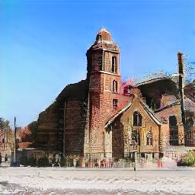
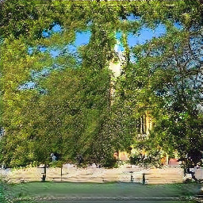
Exercise 3: Testing causal relationships
http://bit.ly/sidn-gandissect
Generated
Tree units off
Tree units on

Slide 14
Vision lab exercise 4
http://bit.ly/sidn-gandissect
Exercise 4: Comparing different objects
How are objects such as doors or domes represented?
Goal: causal experiments on the representations of different visual objects.
(5 minutes)

Slide 15
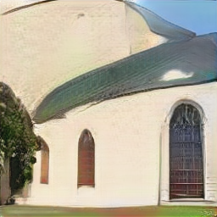
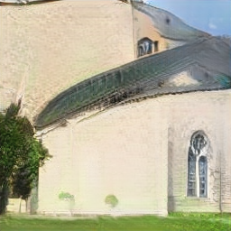
Exercise 4: Comparing different objects
http://bit.ly/sidn-gandissect

Slide 16
Vision lab exercise 5
http://bit.ly/sidn-gandissect
Exercise 5. Compare the content in different layers and models.
Goal: find if different types of concepts are represented in different layers.
(5 minutes.)

Slide 17
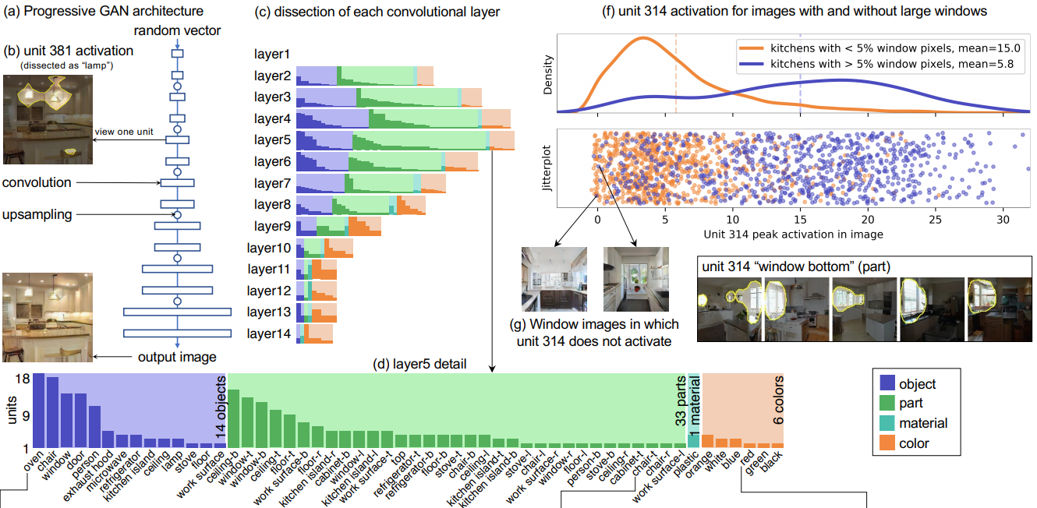
Exercise 5: comparing layers
http://bit.ly/sidn-gandissect

Slide 18
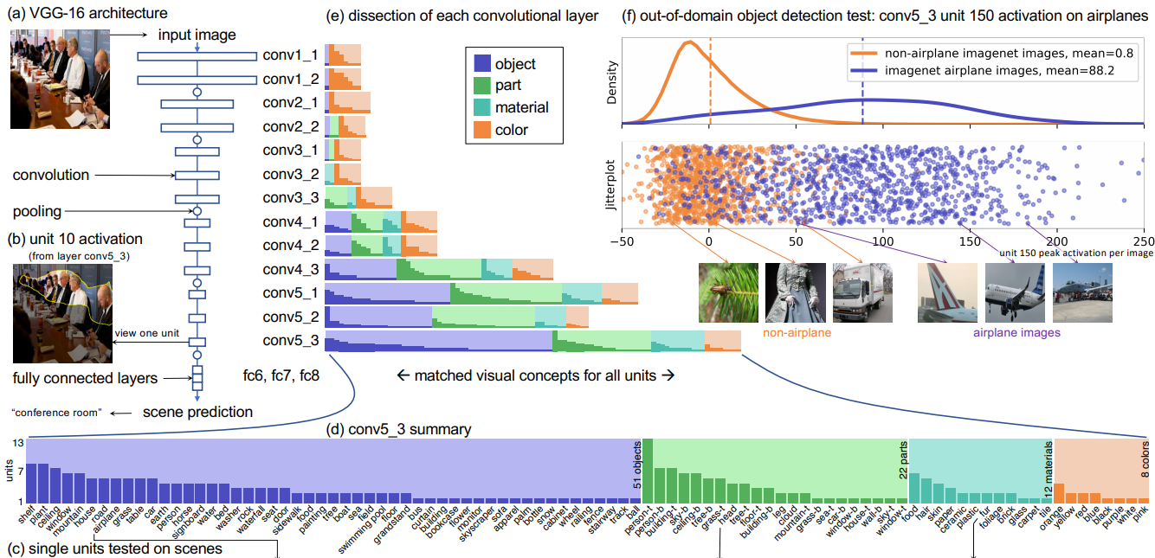
Comparing another model (classifier)
http://bit.ly/sidn-gandissect

Slide 19
Vision lab: solutions
http://bit.ly/sidn-gandissect
bit.ly/sidn-gand-solution

Slide 20
Language: probing classifiers
Q: a linguistic property. We will focus on the part of speech of every word
pronoun verb pronoun det noun She gave me a raise
R: word representations from a pre-trained language model
f: R → Q: the probing classifier, such as a linear classifier

Slide 21
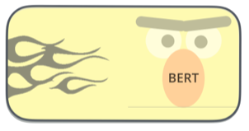
Language: probing classifiers
We will use BERT as our representation R
A deep transformer language model that achieved state-of-the-art results in many NLP tasks
BERT is trained to “fill in the blank”:
She <MASK> me a raise
gave
[Figure: http://jalammar.github.io/illustrated-bert/]

Slide 22
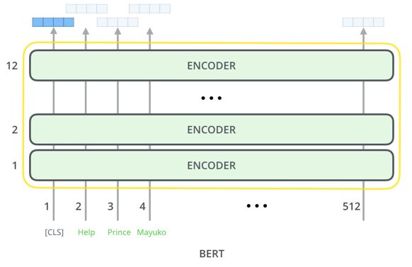
Language: probing classifiers
We’ll analyze BERT-base:
12 layers 768 hidden dims 12 attention heads 110M total parameters
[Figure: http://jalammar.github.io/illustrated-bert/]

Slide 23
Language lab
bit.ly/sidn-probe
bit.ly/sidn-probe

Slide 24
Language lab: Exercise 1
bit.ly/sidn-probe
Exercise 1: Training a probing classifier f on part-of-speech (POS) tagging
Run the notebook
Observe the resulting accuracy.
What does it mean?

Slide 25
Language lab: Exercise 1
bit.ly/sidn-probe
Exercise 1: Training a probing classifier f on part-of-speech (POS) tagging
Run the notebook
Observe the resulting accuracy. Test accuracy: 91.7
What does it mean?

Slide 26
Language lab: Exercise 2
bit.ly/sidn-probe
Exercise 2: Compare representations R at different layers
Implement a separate probing experiment for each layer in BERT.
Compare the POS accuracies from different layers.
What do they tell us about what BERT learns about language?

Slide 27
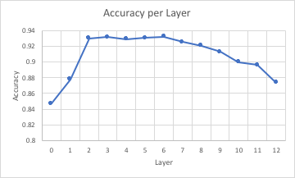
Language lab: Exercise 2
bit.ly/sidn-probe
Exercise 2: Compare representations R at different layers
Implement a separate probing experiment for each layer in BERT.
Compare the POS accuracies from different layers.
What do they tell us about what BERT learns about language?

Slide 28
Language lab: Exercise 3
bit.ly/sidn-probe
Exercise 3: Compare different probing models f
Implement a non-linear probing classifier.
Compare the POS accuracies from different layers with different classifiers.
What do they tell us about what BERT learns about language?

Slide 29
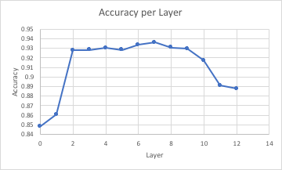
Language lab: Exercise 3
bit.ly/sidn-probe
Exercise 3: Compare different probing models f
Implement a non-linear probing classifier.
Compare the POS accuracies from different layers with different classifiers.
What do they tell us about what BERT learns about language?

Slide 30
Language lab: Exercise 4
bit.ly/sidn-probe
Exercise 4: Control checks for probing classifiers
Implement a control experiment: predict random labels.
Calculate the selectivity per layer, defined as the difference between real and control accuracies.
What do they tell us about what BERT learns about language?

Slide 31
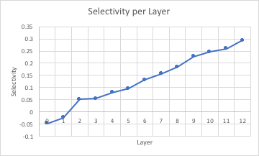
Language lab: Exercise 4
bit.ly/sidn-probe
Exercise 4: Control checks for probing classifiers
Implement a control experiment: predict random labels.
Calculate the selectivity per layer, defined as the difference between real and control accuracies.
What do they tell us about what BERT learns about language?

Slide 32
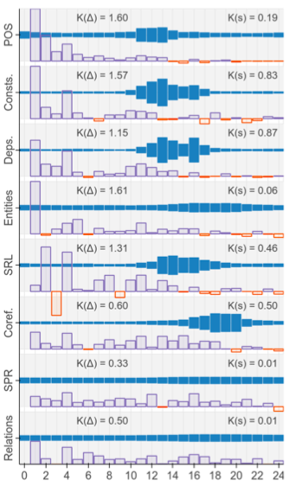
Language lab: Takeaways
bit.ly/sidn-probe
Models like BERT learn a lot about various language properties
Different layers learn different aspects to different extents
Or rather: different layers make information more or less accessible
Control checks can help separate f from R (but this is tricky)
[Figure: Tenney et al. 2019]

Slide 33
Language lab: solutions
bit.ly/sidn-probe-sol
bit.ly/sidn-probe-sol

Slide 34
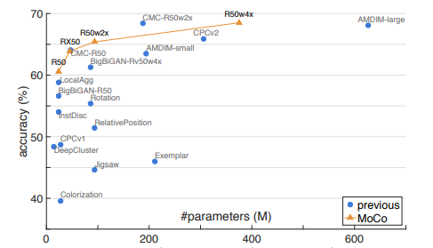
Semantic Tests can be used to Benchmark Unsupervised Training
How can we tell if a model trained unsupervised learns anything interesting?
Use semantic representation tests!
Standard test in images: Q = imagenet classification. R = 2nd-to-last representation layer. f = single-layer linear classifier.

Slide 35
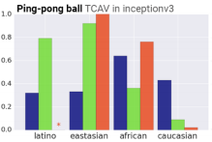
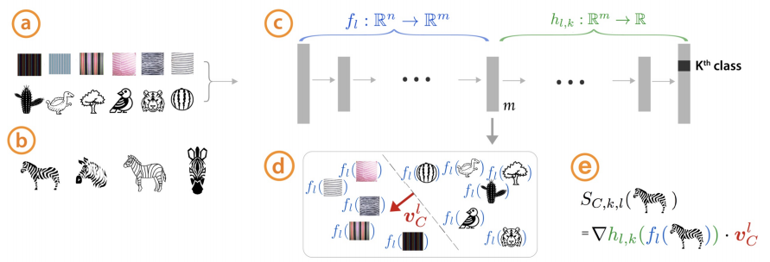
Probing to look for sensitive concepts
TCAV - training custom linear classifiers to probe specific concepts.
Question: can representations reveal biases?
TCAV: Kim, et al, 2017

Slide 36
Conclusion
Do networks learn useful structure for extrapolating beyond what we explicitly teach them?
We can test their ability by training on one task T, and then querying the representation by using it to solve a different query task Q.
We can also test causal relationships between representations and outputs by performing interventions. Does Q → T in a sensible way?

