Slide 1
Structure and Interpretation of Deep Networks
An IAP Practicum 2020
Julius Adebayo, Jacob Andreas, David Bau, Anthony Bau, Yonatan Belinkov, Irene Chen, Sebastian Gehrmann, Jesse Mu, Vitali Petsiuk, Andrew Ross, Shibani Santurkar, Hendrik Strobelt, Mirac Suzgun, Dimitris Tsipras

Slide 2
Welcome
Bring a laptop!
Structure of the class: flipped classroom labs.
Don’t get stuck. Ask us (and help each other) when things don’t work! The point of the labs is to get experience getting things to work.
We will begin most sessions with an lab, and then we will end with a lecture and discussion. Reading the links ahead of time will give you context.

Slide 3
First lab: Why ask How?
bit.ly/sidn-colab-1

Slide 4
First lab debrief
bit.ly/sidn-solutions-1

Slide 5
First lab debrief - Exercise 1
Naive models learn a combination of conceptually distinct decision rules.
Interpretability tools (accuracy differences + saliency maps) helped reveal this.
Larger ML lesson: dataset splits aren’t always commutative; test can generalize to train even if train doesn’t generalize to test
Normal train/test:
97% vs 75%
accuracy
images + saliency maps
Reversed test/train:
94% vs 94%
accuracy

Slide 6
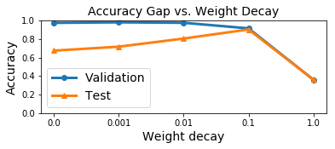
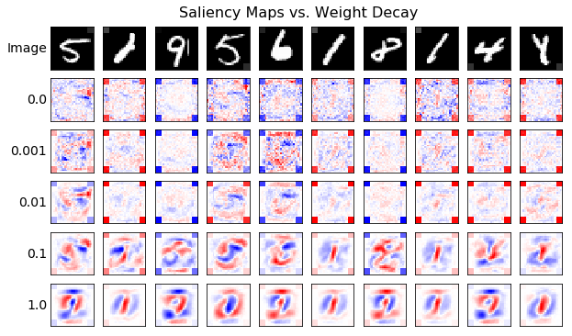
First lab debrief - Exercise 2
Regularization reduced accuracy gaps and smoothed saliency maps.
Larger ML lesson: Changing the training procedure (e.g. the strength and type of regularization) can affect which implicit decision rules models learn, and perhaps also their “interpretability.”

Slide 7
Structure and Interpretation of Deep Networks
Why is model interpretation important?
Why are deep networks are hard to understand?
What approaches are there?

Slide 8
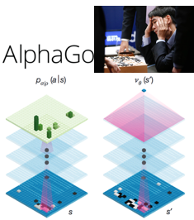
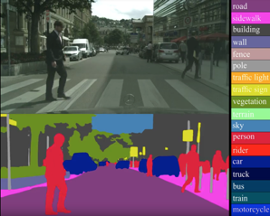
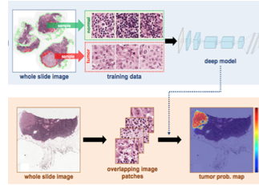
Why ask how? Deep Nets are Everywhere
Self-Driving Cars
Playing Go
Making Medical Decisions
Notes:
I’d like to say a few words about deep net interpretability.
Deep nets have been at the center of a whirlwind of excitement in recent years.
For example, Go is a board game that researchers thought would be too hard for computers to master for another few decades, but recently Google demonstrated a couple different systems that can beat the world champions at the game.
And AI progress is visible everywhere now. The world is working on self-driving cars, where the perception problem seems suddenly tractable. And there are startups everywhere applying AI to things like medical image analysis.
Behind all these things are deep networks. Deep nets work really well at solving a lot of problems, and in some problems they will be unavoidable.
...But deep nets are hard to understand!
How can we possibly have computer programs that we made, but that we don’t understand?

Slide 9
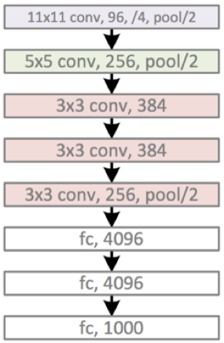
Why a Deep Network ends up being opaque
We train a net to relate input to desired output
Input
Output
middle “hidden” layers
{
Whenever correct: “whatever you did in the middle, do more.”
Whenever wrong: “whatever you did in the middle, do less.”
Eventually, it works very well! But we do not know what the hidden layers learned.
Training algorithm:
Notes:
The thing to realize is that deep nets are self-programming systems. Here is how they are programmed.
A deep net consists of a series of layers. Each layer is a mathematical operation that isn’t set until the network is trained on some data. The middle layers start random.
We train the net on “training data” and adjust middle layers based on how right or wrong it is.
This is called end-to-end training, because we do not really look at the middle, just the ends.
It works surprisingly well. But we do not know what ends up in the middle.

Slide 10
The Deeper they go, the Deeper the Mystery
VGG (2014) 19 layers; acc 91.5%
GoogLeNet (2015) 22 layers; acc 92.2%
ResNet (2016) 152 layers; acc 95.6%
End-to-end training fits the data well…
But the mysterious hidden layers are deeper than ever!
AlexNet (2012) 8 layers; acc 84.7%
Notes:
The old intuition was that nets would be more robust if they had fewer layers and fewer free parameters.
But researchers have discovered that they can actually work better as they get bigger.
This has led to really huge networks lots of unexamined complexity.

Slide 11
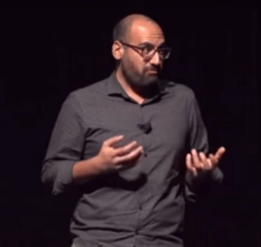
Debate: is empirical evidence enough?
Rahimi: “Machine learning has become alchemy… I would like to live in a society whose systems are built on top of verifiable, rigorous, thorough knowledge, and not on alchemy.”
LeCun: “It's exactly this kind of attitude that lead the ML community to abandon neural nets for over 10 years, despite ample empirical evidence that they worked very well in many situations.”
https://www.youtube.com/watch?v=ORHFOnaEzPc
https://www.facebook.com/yann.lecun/posts/10154938130592143
Debate on sidelines of NIPS 2017
Notes:
This state of affairs has led to a vigorous debate.
Some argue that having so much unexplained behavior is unhealthy.
Others argue that the empirical results are sound, and that it is ok for theory to follow practice.

Slide 12
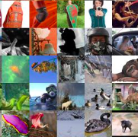
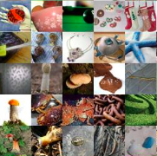
How Deep Networks are Tested
Problem: classify the type of object in the image from a set of 1000 classes. Given: several thousand examples of each class.
Goal: learn what makes a bird look different from a fish, tree, car, etc.
Notes:
To wade into this debate, let us examine how empirical testing is done.
One of the classic problems for deep nets is to classify images.
Here the goal is to identify which type of object is pictured in an image, from 1000 choices.
To learn what makes a bird look different from a fish or a tree, we are given thousands of pictures of birds, and thousands of fishes, and so on.

Slide 13
How Deep Networks are Tested
Memorization is not what we want. How do we know if a net generalizes?
To test this empirically:
1. Split the data. 2. Train on one split. 3. Test on the other split.
Split data
Notes:
How do we test a network’s knowledge?
The real test is not how well a net can REMEMBER that a bird that it has seen is a bird.
The real test is how well a net can GUESS that a bird that it has NEVER SEEN in a bird.
This can be tested by holding back a portion of the data so that the network never sees it during training.

Slide 14
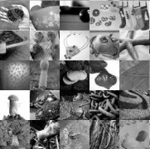
How Deep Networks are Tested
Memorization is not what we want. How do we know if a net generalizes?
To test this empirically:
1. Split the data. 2. Train on one split. 3. Test on the other split.
Train on one split
Notes:
That is, you train on one half of the data.

Slide 15
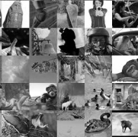
How Deep Networks are Tested
Memorization is not what we want. How do we know if a net generalizes?
To test this empirically:
1. Split the data. 2. Train on one split. 3. Test on the other split.
Answering unseen questions requires a rule that generalizes to unseen data.
Train on one split
Test on the other split … 95% correct ...
Notes:
After training is done, you test how well the network guesses on the other half of the data.
When we say a network is 95% accurate, we mean this is how well it guesses on UNSEEN examples.

Slide 16
How Deep Networks are Tested
Do hold-out tests examine hidden layers?
No.
They learned something to generalize, but we still do not know what they learned.
Train on one split
Test on the other split … 95% correct ...
Notes:
Performance on held-out data is considered the standard way to measure whether a network has learned a GENERALIZED rule.
But notice something.
It is just a clever way to evaluate a rule without actually looking at the rule itself.
Have we had to understand what rule was learned?
Maybe we shouldn’t care!
Empiricists would say “as long as it works, why do we care how it works!”

Slide 17
Why “How” matters: training data bias
What change does this? Alter gray level of random corner pixels, with gray correlated to the digit.
The tiny bit of gray causes the deep net to learn a totally different lesson. Problem: all datasets have biases.
What lessons are your deep nets learning? And how can you tell?
on real digits only 55%!
(Ross 2017 “Right for the Right Reasons”)
Slightly gray here
Notes:
But we saw in the lab today that the rules learned by the model DO matter.
The model we trained seeks out those invisible gray pixels, and starts ignoring what it should be learning.
The takeaway here: a tiny amount of bias in a training set can cause a network to learn a totally different lesson.

Slide 18
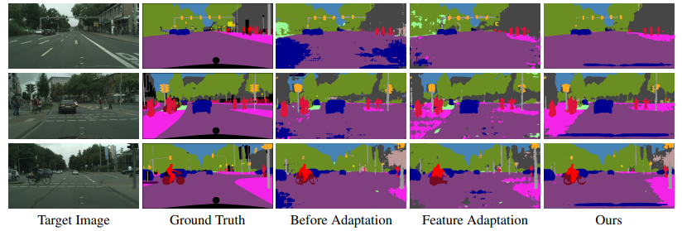
Model bias is a very practical problem
Tsai, Learning to adapt, 2018
Notes:
Biases in training are super important in real applications.
In these pictures, Pink are sidewalks and dark Blue are other cars.
The model was trained on a simulator of American roads, and then tested in various European cities.
In the Middle column you see the result: Sidewalks vanish. Cars show up in all the wrong places. There are all sorts of problems.
So people opening up these models, trying to figure out why they fail, and trying to fix them so that your car can drive in different cities. Some recent attempts at this are shown at the right.

Slide 19
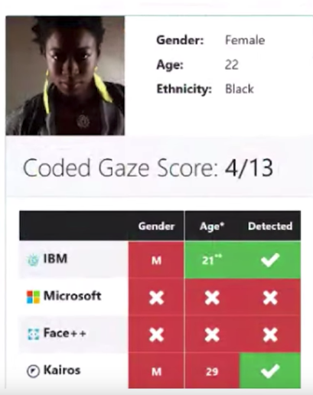
Why “How” matters: Bias and Fairness
Facial recognition: “Gender Shades”, FAT* 2018.
Criminal justice: “Machine Bias”, Propublica 2016.
Healthcare: “Dissecting racial bias in an algorithm used to manage the health of populations”, Science 2019
Natural language processing: “Man is to Computer Programmer as Woman is to Homemaker? Debiasing Word Embeddings”, NeurIPS 2016
Notes:
This leads to a key question: when you use a deep net, what lesson is it learning from your data?
And how can you tell?

Slide 20
Why care how? (Doshi-Velez, Kim)
Robustness. Test data does not cover all situations. The domain can shift. We saw this in today’s lab!
Fairness. We should know when a model is unfairly prejudiced. Users may have a “right to explanation.” Is the network being unfair?
Science. We should understand our models. And our data. Can our networks learn things that humans do not yet know?
Unformulated Goals. The real goals differ from the programmed objective.
Notes:
Robustness to dataset bias is important for making systems that perform well in practice.
But there are other reasons to care how a model works.
For example if a judge sentences you to prison, you can ask why.
Do you have a right to an explanation if an algorithm does it?
Another reason is Science.
What if a model learns something that humanity doesn’t know?
Would we ever learn it? How would we know it?
These problems and others occur when our real goals do not match the exact objectives we use to train a model.
Our REAL hope is not just that a model makes correct predictions.
We REALLY hope for our models to learn how the world WORKS.

Slide 21
Four ways to explain a deep net
A net is not mysterious, just big:
Input: 150,528 pixel val numbers
Multiply by a learned matrix W_{i}
Add a learned vector b_{i}
Drop negatives, add to features
Back to step 1 (100+ times)
Output: 1000 score numbers.
Math for one decision: 11 billion ops
We can explain a deep net in three ways, like how a human programmer would explain a big program:
Text explanation. “Translate the process into plain English.”
Sensitivity analysis. “Trace just the most important codepath.”
Representation analysis. “Explain the high-level data structures.”
Interactive explanations. “Manipulate the internal computations”
All trade off completeness for interpretability.
Notes:
So how can we explain what a deep net is doing?
This is an area of active research.
I don’t have enough time today to explore all the details, but here is a high-level map.
A deep net is not actually so mysterious. It’s just huge. A typical net will take 10 billion mathematical operations to make a single decision.
That’s not all so different from any other big program, except that it wasn’t made by a human programmer.
So when we seek explanations, there are three approaches that are analogues to what we do to understand a human-written program.
First, we can just ask for comments in English.
Second, we can trace out a program’s execution. Here the key in a long trace is to focus on the most important parts of the execution.
Third, we can examine a proram’s data structures. This changes the question from one of how the program thinks, to one of what the program knows.
Let’s look briefly at all three.

Slide 22
Method #1: Textual Explanations
Use a language generation model to map from {representations, salience maps, example sets} to natural language strings
Benefit: possible to concisely summarize complex features and behaviors.
Dilemma: how to ensure that explanations are faithful to the underlying model?
(Hendricks 2016 “Generating Visual Explanations”)
Notes:
Let’s take a very brief look at the three approaches. The first approach is to directly generate explanations in English.
How to do that? Networks are very good at matching complex inputs to complex outputs.
So the idea is: add a second network.
After the primary network makes a decision, for example “this is a cardinal”, the secondary network outputs an explanation, using the first network’s internal state as input. The output will be a sentence like “because it has a red body”.
To train the explanation network, we use a larger dataset contains explanation text.
The explanations you get can be pretty good.
But have we looked at the middle layers? Again, not directly. In fact now, we have even more hidden layers to understand.

Slide 23
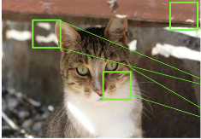
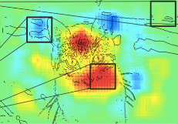
Method #2: Sensitivity Analysis
Trace out just the most important parts.
Method: 1. Trace computation back from output to input 2. At each layer, score importance of each term 3. Show heatmap of input sensitivity
(3) salience heatmap
Highlights important inputs
(images from Bach 2015)
Gradients (Simonyan 2013) Deconvolution (Zeiler 2014) Guided Backprop (Springenberg 2014) Layerwise Relevance Propagation (Bach 2015) CAM (Zhou 2016), GradCAM (Selvaraju 2016) Integrated Gradients (Sundararajan 2017) SmoothGrad (Smilkov 2017) RISE (Petsuik 2018)
(2) Several clever ways to score terms
(1) output: cat
Notes:
Rather than increasing the number of hidden layers, maybe what we want is to cut down on the complexity.
Method #2 does this by trying to identify the subset of the computation that is most decisive for a particular decision.
Here is how it works. First, we have a network make a decision.
Then, we trace the computation backward. At each step, we ask “what were the most important inputs that led to the output at this step.”
At the end, we trace it all the way back to the original input, and this gives us a heatmap of the input that was most important to the decision.
For example, if we ask “why did the network think this picture was a cat”, we get a heatmap highlighting some of the stripes and the whiskers and so on.
There are many different ways of doing this scoring, and so there is a whole line of related research outlining different methods to do this.
Since we are identifying the parts of the input that the model is most sensitive to, it’s called “Sensitivity analysis”

Slide 24
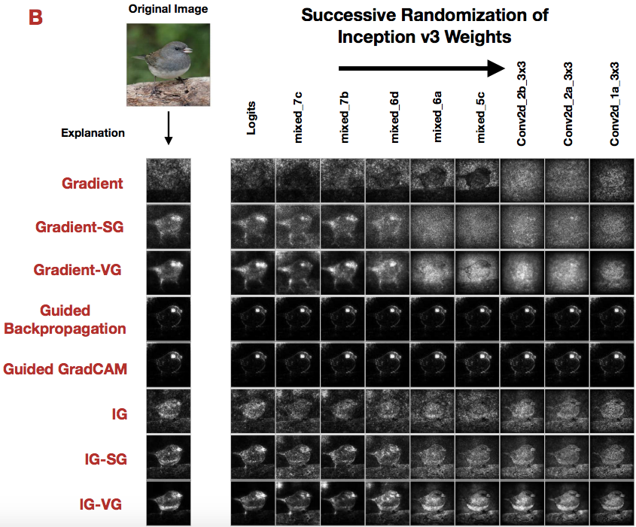
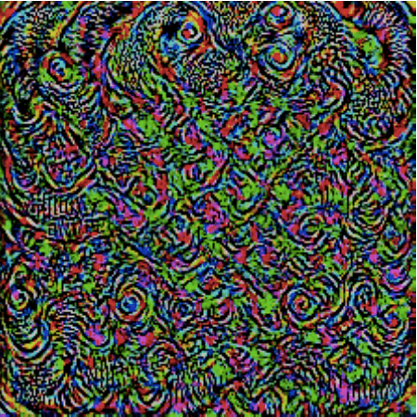
Challenges for Sensitivity Analysis
Pixel sensitivity does not reveal high-level logic.
Difference between “Christmas stocking” and “Indian elephant”? Tiny pixel changes.
This is the basis for adversarial attacks...
Scrambling high layers does not change heatmap!
“Christmas stocking” + tiny perturbation = “Indian elephant”
(Moosavi-Dezfooli 2017 “Universal adversarial perturbations”)
(Adebayo 2018 “Local explanations lack sensitivity”)
Notes:
The idea of asking “what is the smallest change that would result in a different decision” is appealing.
However, we have found that the answer to the question sometimes doesn’t provide as much insight as you would like.
The reason is that sensitivity analysis seems to focus on low-level features, rather than providing insight about high-level concepts.
At left is the answer to “what is the smallest change that would change this stocking to an elephant.”
While it provides a picture of something the network really does, it does not seem to help with understanding how a network generalizes.
At the right is an experiment showing that sensitivity analysis cannot tell the difference between networks where the high-level logic has been scrambled.
The finding is that when the top layers of a network is scrambed, the sensitivity analysis does not change much.
So sensitivity analysis is really giving us a picture of the lowest-level features in a network.
It really is like debugging a program by trying to find important lines of code. If there’s a high-level problem in the architecture, it’s can be hard to understand.

Slide 25
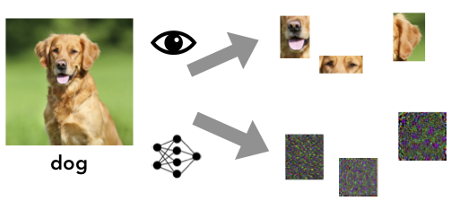
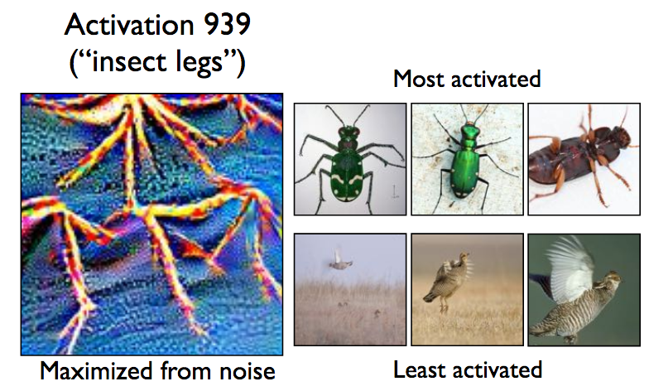
Adversarial Examples and Interpretability
Failure of sensitivity analysis: Could it be linked to how models actually make predictions?
Training models to be human-interpretable: How can we force models to use the “right” features?
Tool: Robustness as a feature prior (enforce invariance to imperceptible input features)
Result: Models use more human-aligned features
Activation 939 ("insect legs")
Surprising discovery: ML Models actually use features that are meaningless to humans
[Jetley et al. 2018; Ilyas et al. 2019; Yin et al. 2019]
most activated
Implication: Can post-hoc explanations be both model-faithful and human-meaningful?
least activated
Notes:
Sensitivity analysis from before fails to produce semantically meaningful changes in the input: is this a failure of the method or do models actually depend on features that make no sense to humans?
Surprisingly, recent work has shown that ML models actually use features that humans can’t even see to make predictions.
Given that standard models depend on features that are not human-meaningful, what kind of interpretability can we even expect? Explanations that make sense to us might hide how models actually make decisions. On the other hand, model-faithful explanations would probably make no sense to us (recall: sensitivity analysis results).
Maybe we need to train models with interpretability as a goal (in addition to accuracy). How do we force them to use the "right" features? Traditionally, this has been done with better architectures, hand-crafted features etc. Here we will explore a new tool: robustness. By forcing models to be robust to small input changes we encourage them to use features that make more sense to us. We will play with robust models and explore what features they use.

Slide 26
Method #3: Representation Analysis
Deep networks organize their internal data:
A network is made up of layers
A layer is made of units (or filters), each producing one output channel.
Input channels are “red”, “blue”, “green”. What do the internal channels mean?
3 Input channels: RGB
256 internal channels produced by layer 5
A net has many layers
A layer has many units
Notes:
This brings us to the third method, which is analogous to looking at the data structures in a network.
A network is made up of layers, and each layer is made up of individual units.
Each unit outputs its own channel. For example, the input of an image has three channels, one for each primary color red, blue, and green.
Inside the network, each layer has a set of units, and so one layer might produce 256 channels.
These do not indicate colors, but maybe they have some other meaning.
Understanding channels is a way of understanding the data structure.

Slide 27
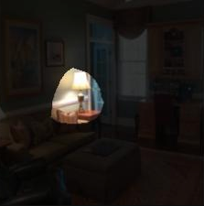
Method #2: Representation Analysis
Goal: reveal the higher-level logic in a network
Network Dissection Method: 1. Identify inputs that trigger internal features 2. Correlate these inputs to human concepts 3. Explain decisions in terms of these concepts
Test input set
(1) identify image regions that activate unit #1 at layer 5
(3) when unit #1 activates: a lamp is observed here
(2) correlation with concept “lamp” is high, IoU 0.23
Notes:
We can examine a channel by asking “what concept correlates with a channel”.
For example, if you look at a single one of the channels in a network trained to classify pictures of places, you will find that it correlates well with parts of images that look like this.
So we have a method called Network Dissection, where we identify the inputs that trigger a feature
Correlate those inputs to human concepts
And explain decieions

Slide 28
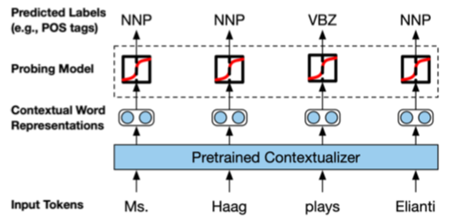
Method #2: Representation Analysis
Probing Classifiers Method:
Collect internal representations
Train auxiliary classifier to predict human annotations
Evaluate quality of classifier as a proxy to representation quality
Notes:
Left figure: illustration of the approach:Collect representations from a pretrained model, train an auxiliary classifier to predict parts of speech, and evaluate classification accuracy
Right figure: results from different layers of two models on a range of tasks. Every column is one linguistic property (part-of-speech tagging, named-entity recognition, chunking, etc.). Every row is a layer. Colors correspond to classification accuracy. Notice that different layers work better for different properties.

Slide 29
Challenges for Representation Analysis
Representations entangle concepts, so concepts need to be disentangled in order to read explanations.
This unit is sensitive to airplanes, houses, and faces. What is the purpose of this unit?
Characterizing features requires a good dictionary of human concepts. Many concepts in a representation are not yet identified.
46% of units correspond to an identified concept. What do the other 54% of units do?
airplane house house faces indoor airplane
118 / 256 units match with an identified concept
Notes:
The main problem with representation analysis is that units are not always so easy to understand. For example, in the network on the right, about 46% of units correspond to an identified concept, leading to the question, what do the other 54% of units do?

Slide 30
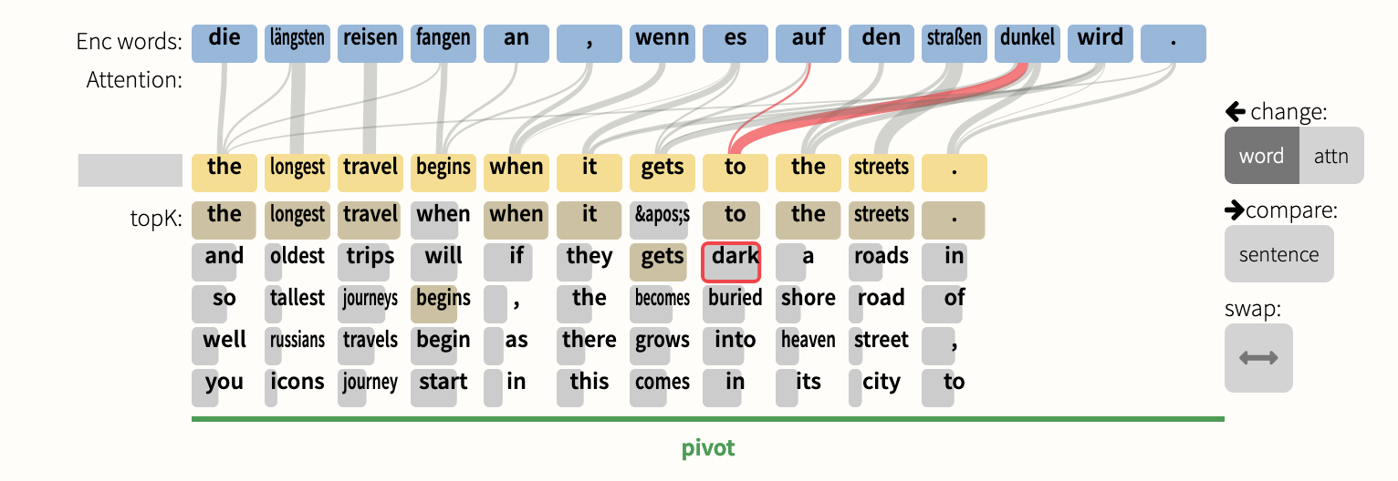
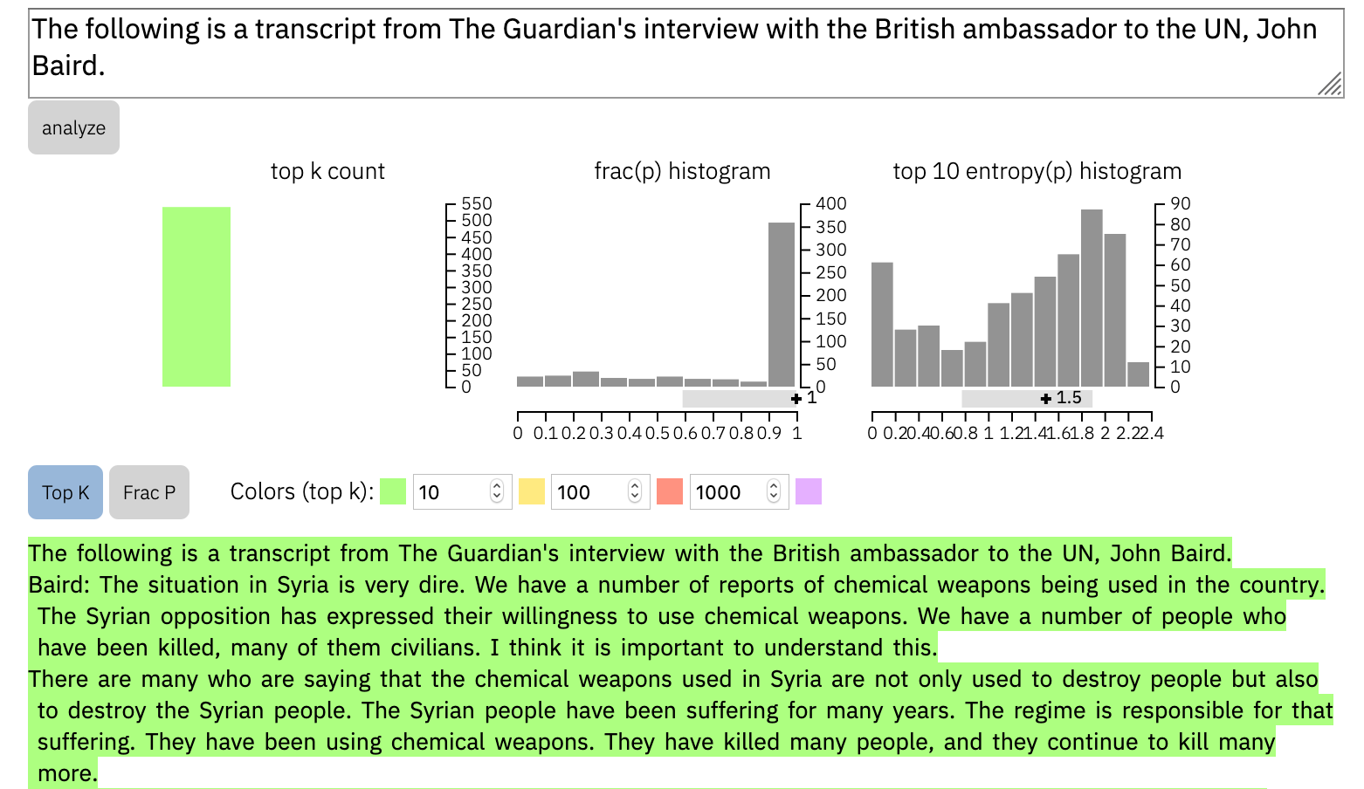
Method #4: Interactive explanation
Hypothesis generation using interaction
What-if diagnostics and debugging to understand the model behavior and data characteristics
Starting point for new questions based on observations while “playing”

Slide 31
Recap of methods
Why deep nets are hard to explain: End-to-end training creates many hidden layers with billions of math operations. Why explanations are important: Training is always biased. Explanations can reveal if biases are acceptable. Four approaches to explaining deep nets:
1. Sensitivity analysis 2. Representation analysis 3. Textual explanations 4. Interaction
Notes:
Recap: deep nets are hard to explain, because they are so big.
But explanations are important, because testing alone cannot reveal the reasons a network makes the decisions that it does.
There are three approaches for making explanations.
One is to add explainer nets; another is to trace the most salient computations, and another is to analyze the data structures.

Slide 32
Learning Objectives and Topics
After this class, you will:
Know how to use several deep network interpretation methods.
Be able to discuss some of the strengths and weaknesses of various approaches.
Have enough context to follow interpretability research and use new methods.
Specific topics:
Important topics not covered in depth:
Non-deep-network interpretable ML.
Benchmarks for interpretable methods.
Architectures interpretable by design
Explaining decisions (saliency maps)
Explaining models (representation maps)
Adversaries and interpretability
Bias and Fairness
Interactive explanations
Textual explanations

Slide 33
Structure of the class
Each day will start with a lab, so you should
Bring a laptop!
Read the reading, for background!
Ask for help if you get stuck!
The point is to get some experience in looking at how networks work inside.
Course website: http://sidn.csail.mit.edu/
All materials will be posted.

